Slide 1
CAR PRICE PREDICTION

Slide 2
INTRODUCTION ABOUT DATASET
A Chinese automobile company Geely Auto aspires to enter the US market by setting up their manufacturing unit there and producing cars locally to give competition to their US and European counterparts.
They have contracted an automobile consulting company to understand the factors on which the pricing of cars depends. Specifically, they want to understand the factors affecting the pricing of cars in the American market, since those may be very different from the Chinese market. The company wants to know:
Which variables are significant in predicting the price of a car
How well those variables describe the price of a car
Based on various market surveys, the consulting firm has gathered a large data set of different types of cars across the America market.

Slide 3
Goal :
We are required to model the price of cars with the available independent variables.
It will be used by the management to understand how exactly the prices vary with the independent variables.

Slide 4
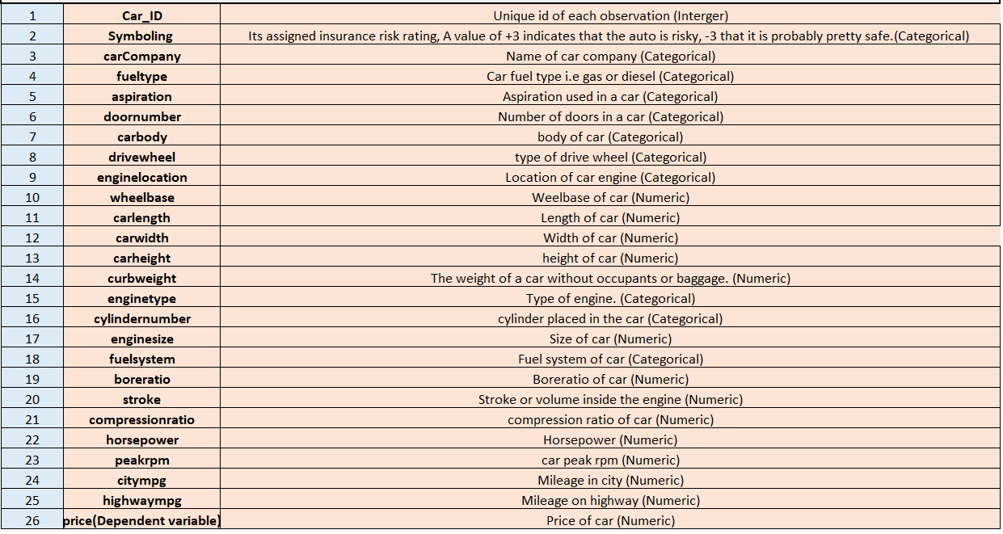
Features in the dataset :

Slide 5
FEATURES AND PROCESSING
This dataset have 205 rows and 26 columns .
Few features like ‘cylindernumber’ and ‘doornumber’ which are categorical was replaced with their numeric value .
e.g., 'four':4, 'six':6, 'five':5, 'three':3, 'twelve':12, 'two':2, 'eight':8
In the feature ‘carname’ I’m considering only first word.

Slide 6
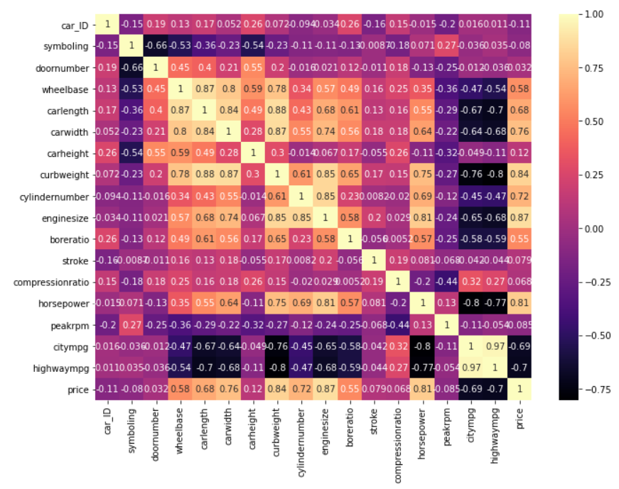
Correlation

Slide 7
Preprocessing
Here I used all the columns without dropping any of them .
Used get_dummies for the categorical features 'fueltype','enginelocation','aspiration','drivewheel','carbody','fuelsystem','enginetype','CarName’ .
Scaled all the independent variables .
The test split I have chosen is 70:30

Slide 8
Models score and performance metrices

